Slide 1

.edu SHARE
free Program
Free for all universities

Slide 2
With XQual SHARE program
  deliver a better learning experience to your students
if you are a ‘.edu’
{
get your free unlimited license
& free support
& free maintenance
& free e-learning access
}

Slide 3

Support your teaching
  with real life exercises using a first class solution

Slide 4
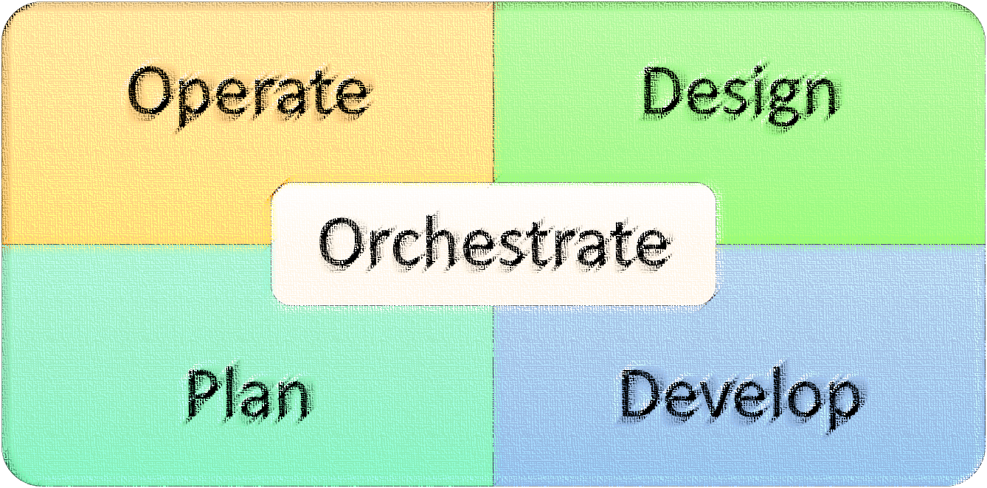
Teach professional testing skills
  Cover all testers skills and practices

Slide 5

Quality-driven development skills
  Extend XStudio EcoSystem

Slide 6
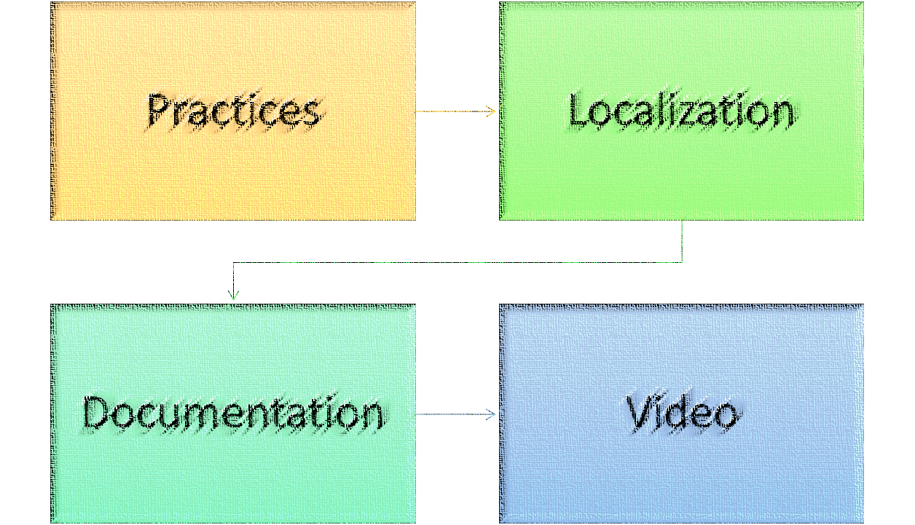
Smart learning experiences
  Improve XStudio tools

Slide 7

.edu Share Program
Support your teaching practices
Real-life exercises
Using first-class solution

Slide 8
When Quality really matters
WWW.XQUAL.COM

